Slide 1
Welcome to Making Connections! GIFTED CLUSTER teachers Norview Elementary 2024-2025 Gifted Education & Academic Rigor Services! Ms. Fairweather-gifted resource teacher

Slide 2
who AM I !!
My name is Fonda Fairweather, and I have the honor of working with your gifted/emergent scholars this year. A little about me. I have 35 years of teaching experience. I hold a Bachelor’s Degree from San Diego State University, a Master’s Degree in Reading from Grand Canyon University, an endorsement in Library Media from Old Dominion University, a Gifted Endorsement from Regent University, lifetime certification from the University of California San Diego for Gifted, and eight years of experience as a Gifted/Seminar teacher with San Diego Unified School District. I have worked for NPS for 25 years as a 5th-grade teacher, Library Media Specialist, and GRT.

Slide 3
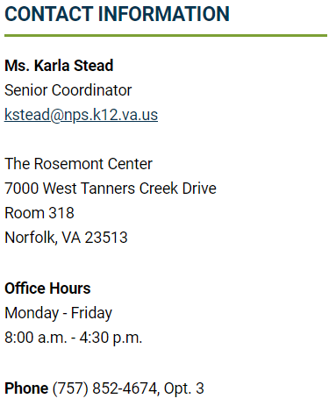
What is gifted services??
The Office of Gifted Education & Academic Rigor Services works to develop the gifts and talents evident in our children by working with all of our stakeholders to create a wide range of engaging learning experiences that nurture our students’ social, academic, and emotional growth. Watch "I Am Gifted“
Gifted Education & Academic Rigor Services / Overview (npsk12.com)

Slide 4
What is my child’s identification and what does it mean?
Children are identified using 5 criteria: CogAT test scores, teacher rating form, parent rating form, portfolio and interview.(The Cognitive Abilities Test (CogAT) is a multiple-choice K-12 assessment that measures reasoning skills with different types of verbal, quantitative, and nonverbal questions)
Students who are identified gifted are identified in one of several ways: Reading, Math, Reading and Math, General Intellectual Aptitude (GIA).
If a child has any of those identifications, he/she will receive gifted services. Your child’s ID can not be taken away; it will stay with them as long as they are in Norfolk Public Schools.
Norfolk’s Local Plan for gifted education states that your child will be part of a cluster class and/or will receive services from the gifted teacher.
Pull out or push in model; cluster grouping; collaboration
Notes:
The Cognitive Abilities Test (CogAT) is a multiple-choice K-12 assessment that measures reasoning skills with different types of verbal, quantitative, and nonverbal questions

Slide 5
What is an Emergent scholar?
The Emergent Scholars program is all about supporting and nurturing the academic potential of young minds.
We work to identify students who might not be considered for enrichment programs using traditional methods.
Our goal is to empower underrepresented students, encourage and mentor them to take on challenging courses, and involve parents in the process.
If a child has any of those identifications, he/she will receive gifted services. The child’s ID can not be taken away; it will stay with them as long as they are in Norfolk Public Schools.

Slide 6
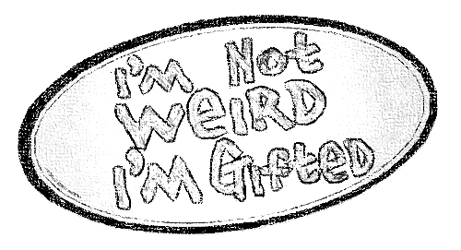
How will my students receives gifted services?
Currently I am pushing into grades 1-5 classes for instruction.
Norview ES(Monday-Friday)
We will be using Google Classroom & Canvas for asynchronous assignments.
Google Classroom-https://classroom.google.com/c/MzQ1NDg4Mzg1OTY5
Canvas-Gifted Class & Resources (instructure.com)
A notice on ClassDojo for joining my Google Classroom https://teach.classdojo.com/#/launchpad /Canvas will go out tomorrow! ☺
Additional information is posted on the school website under the Our Families tab
Norview: Norview Elementary School / Homepage (npsk12.com)

Slide 7
How will I know how
my child/student
is doing in
gifted?
I do not give grades; however, I do give a progress report or quarterly evaluation.
I collaborate with the classroom teacher about behavior and academics. Classroom grades are PRIORITY!
Communication with parents: Class Dojo for progress reports, notes and/or phone calls, email as needed.

Slide 8
Testing When testing is going on, we will not have groups. I will notify you on Class Tag or Class Dojo. However, I will collaborate with teachers about assignments and there may be some asynchronous work on Canvas & google classroom.
September: Soliciting for students to test(GEMS)
November: Gifted testing for referred students in grades 2-5
February: Gifted testing for all first-grade students
May: SOLs
Classroom testing (STAR, benchmarks, etc.)

Slide 10
2nd and 3rd | 4th and 5th
Learning Style Inventory Junior Great Books Questioning strategies Exemplars (logic problems) Mathological Liar Math Challenge 24 Primer Checker/Chess Logic Safari | Learning Style Inventory Junior Great Books/Shared Inquiry Jacob’s Ladder Exemplars (logic problems) Math Challenge 24 Mathological Liar Hands on Math Equations Chess Bridge
Curriculum

Slide 12
Links to Learn More About our g.e.a.r.s. Curriculum
Junior Great Books: https://www.greatbooks.org/junior-great-books-k-5/
Jacob’s Ladder: https://education.wm.edu/centers/cfge/curriculum/languagearts/materials/jacobsladders/index.php
One Hour Mysteries: https://www.rainbowresource.com/category/3481/One-Hour-Mysteries.html
Logic Safari: https://www.routledge.com/Logic-Safari-Book-1-Grades-2-3/Risby/p/book/9781593630898
Exemplars: https://exemplars.com/
Noetic Math: https://www.noetic-learning.com/
Math Challenge 24: 24 Challenge® Math Program (24game.com)

Slide 13
E-mail is the easiest way to reach us:
Ms. Fairweather
ffairwe@nps.k12.va.us
Norview ES
757-852-4660
Ext. 3016
Room #6

Slide 14
Coming Soon!!! Arts/Science Clubs 24 Challenge Math Competition Chess Club Reminder-Please return parent rubric & permission test by Monday, sept. 30,2024!

Slide 15
The way to get started is to quit talking and begin doing.
Walt Disney

